Slide 1

The EV Revolution: Global EV Trends Uncovered Through Data
Caleb Cedeno - ITEC 3170 Project - Spring Semester 2025

Slide 2
Contents
00
01
02
03
04
05
Project Purpose
Dataset Summary
Dataset Manipulation
Analysis
Visualizations
Conclusion
Caleb Cedeno - ITEC 3170 Project - Spring Semester 2025

Slide 3

Purpose
Purpose of the following presentation
The purpose of this presentation is to explore and analyze global electric vehicle (EV) sales data from 2010 to 2024. By using data-intensive techniques, we aim to uncover regional trends, highlight market growth, and understand the impact of EV adoption across different countries (specifically developed vs developing). Why? Emerging technologies like AI and self driving capabilities of EVs spark interest in one of the fastest-growing industries in the world, and how its changed the automotive market.
Caleb Cedeno - ITEC 3170 Project - Spring Semester 2025

Slide 4
Dataset Summary
Global Coverage of EV Trends
Breakdown of Vehicle Types and Powertrains
Annual Sales Performance and Different Metrics
The dataset includes electric vehicle data points from countries and regions across the world, offering a comprehensive view of how EV adoption has progressed globally from 2010 through early 2024.
It categorizes EVs by mode (e.g., passenger cars, buses), powertrain (e.g., battery electric vehicles [BEVs], plug-in hybrids [PHEVs]), and unit types, enabling in-depth comparisons and trend analysis by vehicle type.
Parameters measured include electricity demand, EV charging points, EV sales, EV sales share, EV stock, EV, stock share, etc.
Caleb Cedeno - ITEC 3170 Project - Spring Semester 2025

Slide 5
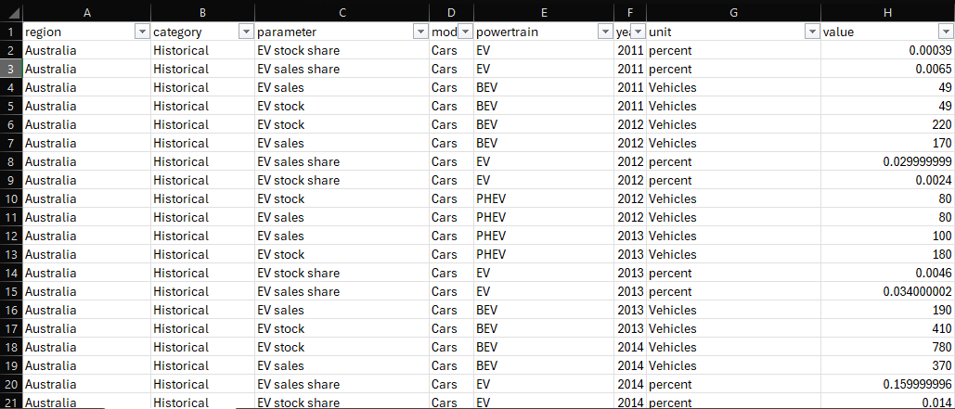
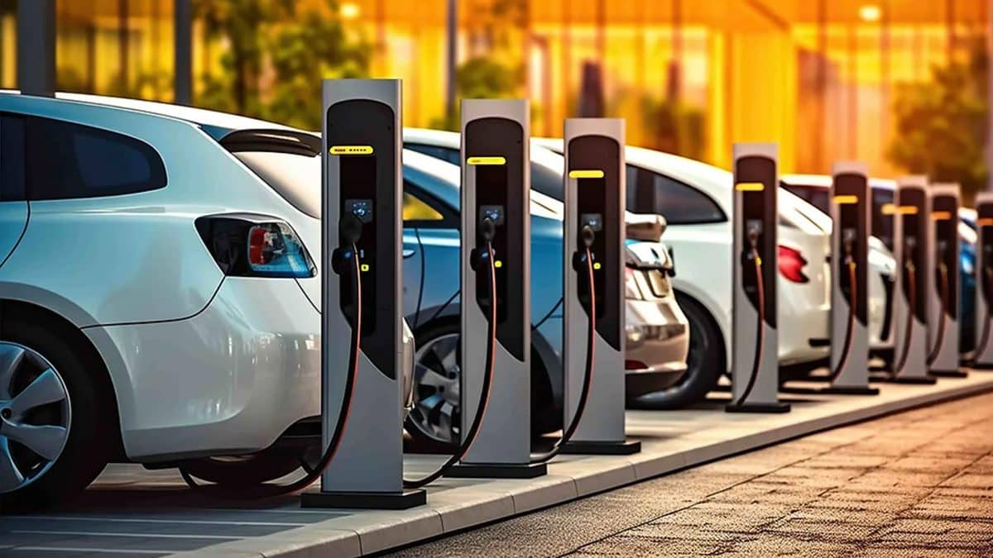
Dataset Overview
Offerings

Slide 6
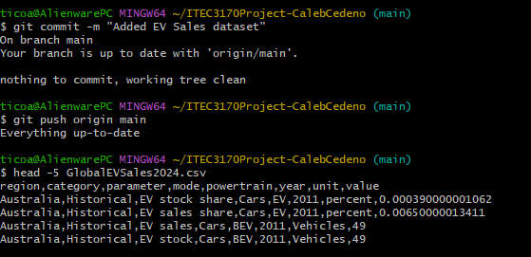

Dataset Manipulation
With only 8 columns within the dataset we kept all columns to not lose any potentially relevant data down the line. Manageable, approximately 12,000+ values
Manual dataset download and load due to authentication required when using kaggle datasets.
Dataset inspection using head to get a feel for the data we are working with. Will any columns need to be dropped due to little or zero value.
Caleb Cedeno - ITEC 3170 Project - Spring Semester 2025

Slide 7
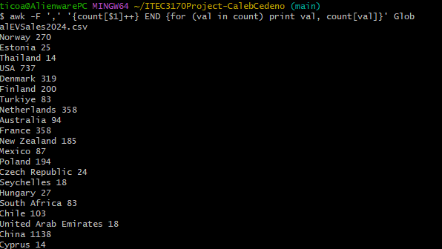
Dataset Analysis
Initial Data Point Analysis with awk
For each line in the file, it's looking at column 1, which is region, and counting how many times each region appears
Example: 270 EV records found for Norway in dataset against 14 records for Cyprus
Initial insights: Which countries have more EV data available or which countries are more active in the EV market depending on interpretation.
Caleb Cedeno - ITEC 3170 Project - Spring Semester 2025

Slide 8
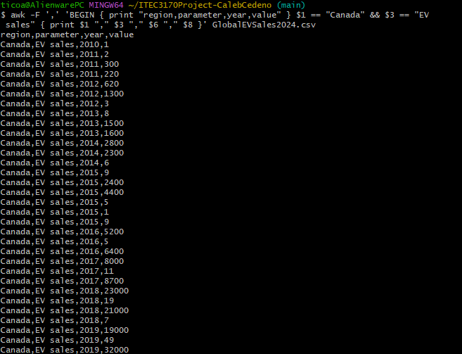
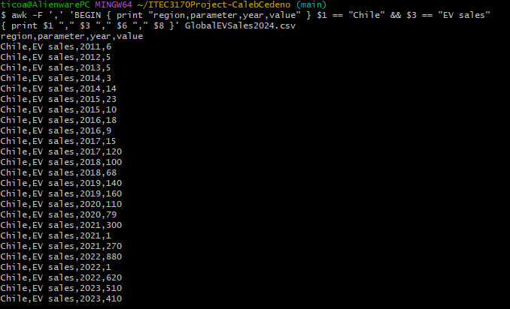
Dataset Analysis
EV Sales Comparison for Developed Country vs Developing Country
Developed Country: Characterized by high quality of life, developed economy, and advanced technological infrastructure compared to less industrialized nations, often measured by GDP. eg: United States, Canada, Japan, many countries in Europe, and Australia.
Filtering data to show sales data points throughout the years for a developed country compared to a developing country
Initial insights: Once again more EV data points available for the developed country. Additionally we can see a continuous exponential growth in EV sales for Canada compared to a slower growth for Chile.
Caleb Cedeno - ITEC 3170 Project - Spring Semester 2025

Slide 9
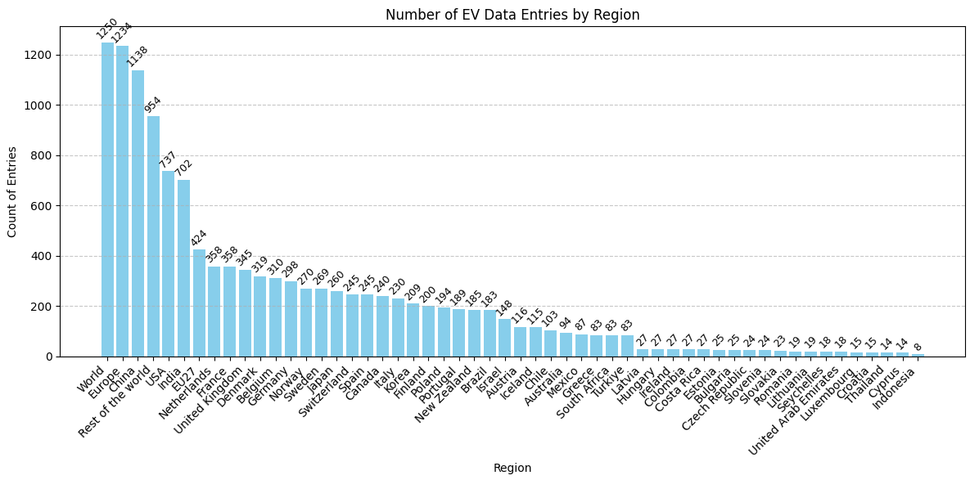
Visualizations
Which regions have the most data entries in the dataset
Helps identify where most of EV reporting is coming from
Caleb Cedeno - ITEC 3170 Project - Spring Semester 2025

Slide 10
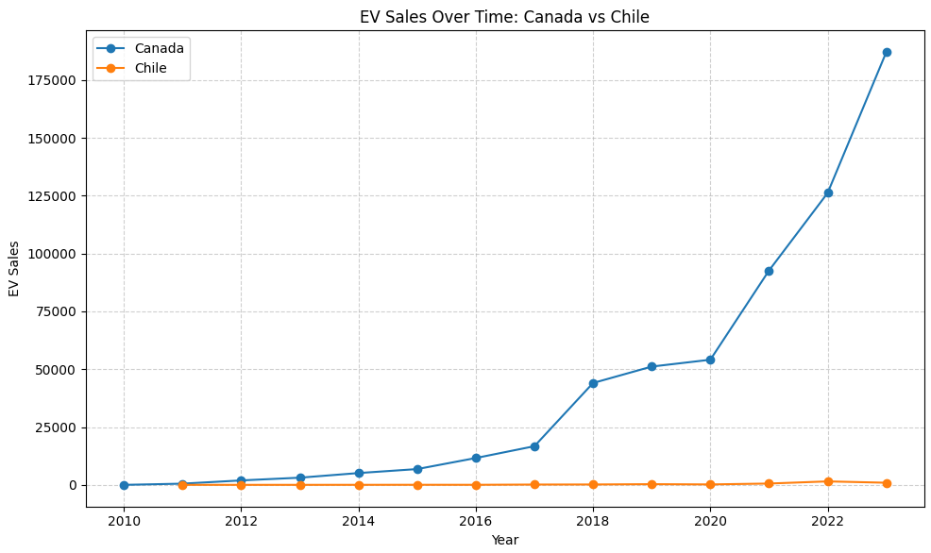
Visualizations
Line graph for sales comparison of Canada vs Chile
Easy to compare EV market growth of the two regions over the years
Caleb Cedeno - ITEC 3170 Project - Spring Semester 2025

Slide 11
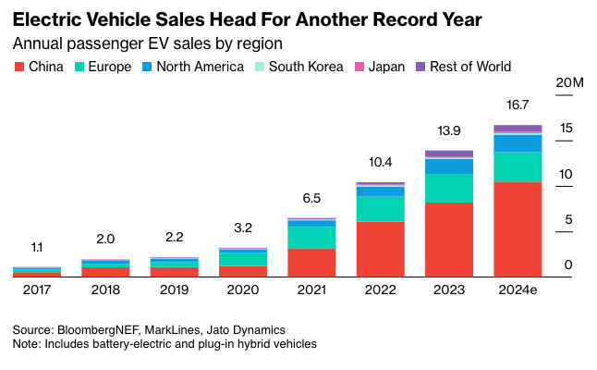
Conclusion
“
Data Insights <- Balance -> Traditional Methods
Caleb Cedeno - ITEC 3170 Project - Spring Semester 2025

Slide 12

Thank You!
Open for Q&A
Caleb Cedeno - ITEC 3170 Project - Spring Semester 2025

Slide 13
References
Ford, P. L. (2024, July 19). Global EV Sales: 2010-2024. Kaggle. https://www.kaggle.com/datasets/patricklford/global-ev-sales-2010-2024
Github Repo: https://github.com/ccedeno2/ITEC3170Project-CalebCedeno
Caleb Cedeno - ITEC 3170 Project - Spring Semester 2025

